Slide 1
UNIT - 3

Slide 2
Population
The entire group of individuals is called the population.
Ex: To study the height of the people of india, population is the set of heights of all people in india.

Slide 3
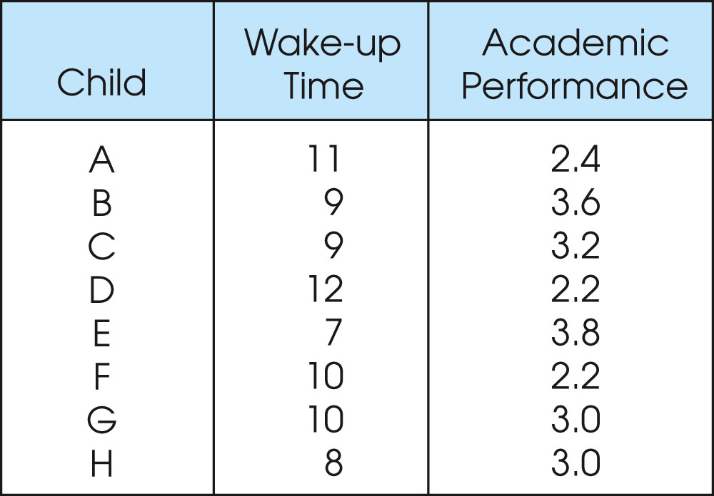
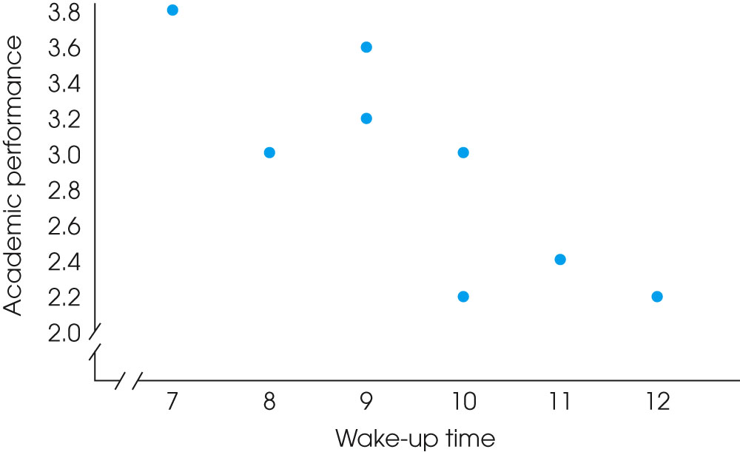
Notes:
Figure 1.4
One of two data structures for studies evaluating the relationship between variables. Note that there are two separate measurements for each individual (wake-up time and academic performance). The same scores are shown in a table (a) and in a graph (b).

Slide 4
Sample
Usually populations are so large that one cannot examine the entire group.
Therefore, a sample is selected to represent the population in a study.
It is the subset of the population.
The goal is to use the results obtained from the sample to help answer questions about the population.

Slide 5
Sample selection
More than one sample can be derived from the same population.
We typically cannot measure all subjects and we have to limit ourselves to investigate a (hopefully representative) random sample taken from this group.

Slide 6
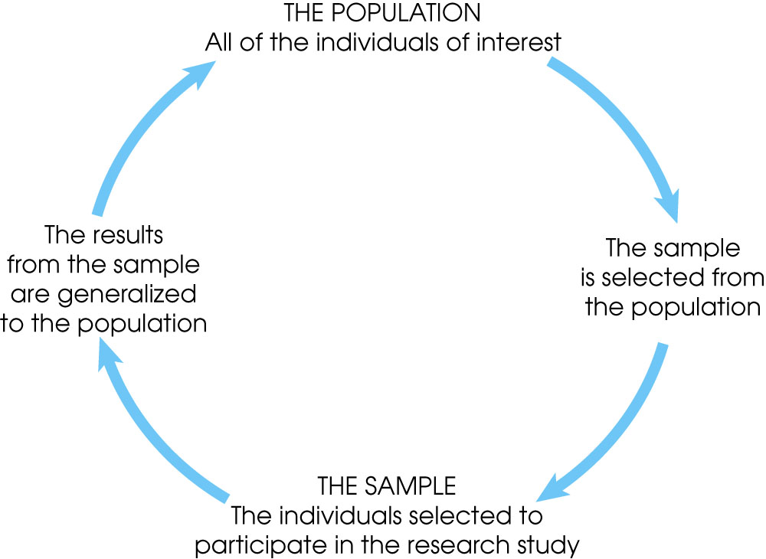
Notes:
Figure 1.1
The relationship between a population and a sample.

Slide 7
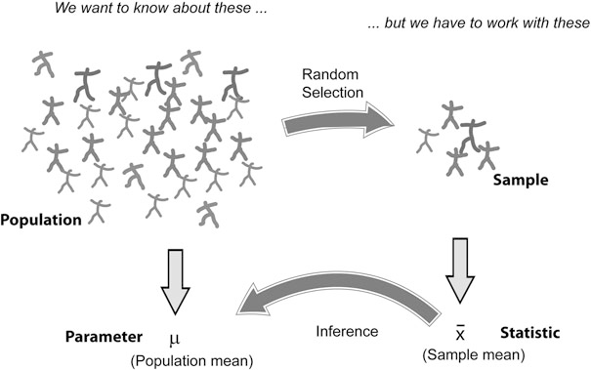

Slide 8
Central tendency
It gives the basic understanding about the distribution of data around the central value.
It has 3 sub topics:
    Mean
    Median
    Mode

Slide 9
Distribution Center
When we have a data sample from a distribution, we can characterize the center of the distribution with different parameters.
Thereby the data can be evaluated in two
ways:
1. By their value.
2. By their rank (i.e., their list-number when they are ordered according to magnitude).

Slide 10
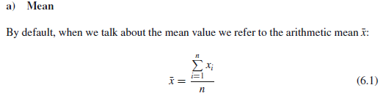
Mean
Mean is the average of all the observed values.
It gives an understanding of the population

Slide 11
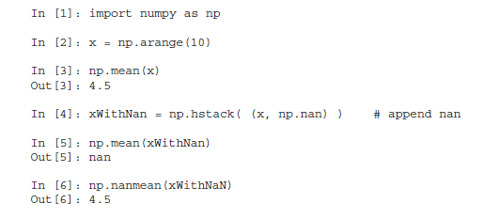
Mean

Slide 12
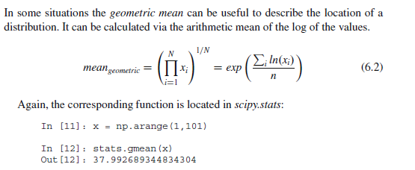
Geometric Mean

Slide 13

Median
Median is the middle value of the distribution

Slide 14
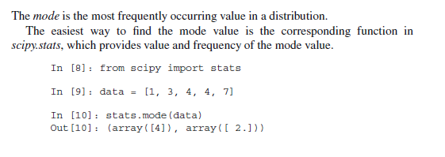
Mode

Slide 15
Mode

Slide 16
The Population vs. The Sample
We will likely never know these (population parameters - these are things that we want to know about in the population)
The population
Number = N
Mean = μ
Standard deviation = σ
Cannot afford to measure parameters of the whole population

Slide 17
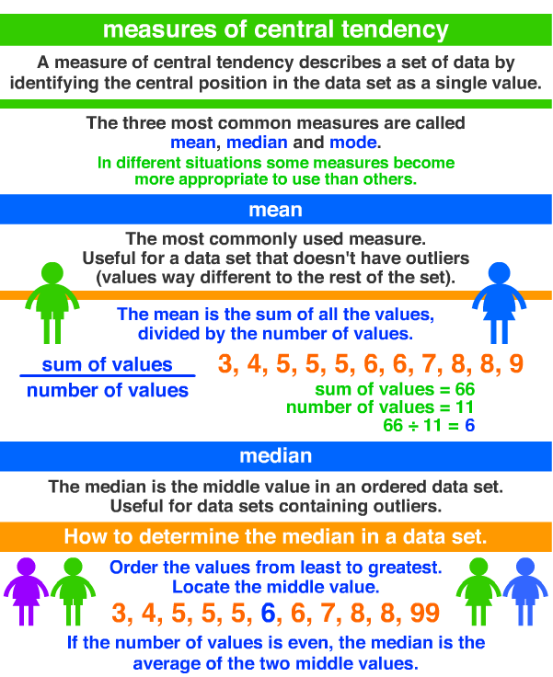

Slide 18
Measures of variability
Variability means ‘Scatter’ or ‘Spread’.
Measure of spread gives the variability in the data and how well the data is distributed.
There are four measures of variability:
  1. Range
  2. Quartile
  3. Variance
  4. Standard Deviation

Slide 19
Need of Variability
Helps to ascertain the measures of deviation
It helps to compare different groups
It is useful to supplement the information provided by the measures of central tendency
It is useful to calculate further advance statistics based on the measures of dispersion.

Slide 20
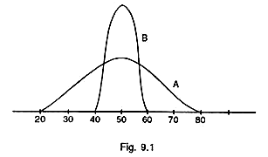
Need of Variability
Consider two groups.
50 boys and 50 girls in each group.
Mean = 50
There is no difference in the performance of the two groups.
But suppose the boys’ scores are found to range from 20 to 80 and the girls’ scores range from 40 to 60.

Slide 21
Need of Variability
This difference in range shows that the boys are more variable, because they cover more territory than the girls.
Group A is three times as variable as group-B-Spreads over three times the distance on the scale of scores-though both distributions have the same central tendency.

Slide 22
The Range
It is the difference between the highest and the least value.
It is the most general measure of spread or scatter.
Range = H—L
Ex: 22, 48, 43, 60, 55, 25, 15, 45, 35, 68, 50, 70, 35, 40, 42, 48, 53, 44, 55, 52
Range=70-15=55
range=np.ptp(x)

Slide 23
The Range
Range is effected by outliers,
Outliers are the data points with a value much higher or lower than the rest of the data.
Outlier
A data point that is distinctly separate from the rest of the data. One definition of outlier is any data point more than 1.5 interquartile ranges (IQRs) below the first quartile or above the third quartile.

Slide 24
The Range
Merits of Range:
It is the simplest measure of variability.
Demerits of Range:
Range is greatly affected by fluctuation of scores.
It is not based on all the observations of the series. It only takes the highest and the lowest scores in to account.

Slide 25
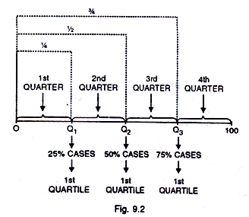
Quartile
The data is divided into 4 groups.

Slide 26
Quartile
Q₁ is position in a distribution below which 25% cases, and above which 75% cases lie.
Q2 is a position below and above which 50% cases lie. It is the Median of the distribution.
The 3rd quartile or Qg is the 75th percentile, below which 75% cases and above which 25% cases lie.

Slide 27
Quartile
Inter Quartile range (IQR) = (Q3-Q1)/2
Q1= np.percentile(x,25)
Q2= np.percentile(x,50)
Q3= np.percentile(x,75)

Slide 28
Finding outliers
Ex10.2, 14.1, 14.4. 14.4, 14.4, 14.5, 14.5, 14.6, 14.7, 14.7, 14.7, 14.9, 15.1, 15.9, 16.4
N=15
Then Q₂ = 14.6. as (15 + 1) ÷ 2 = 8
The two halves are:
10.2, 14.1, 14.4. 14.4, 14.4, 14.5, 14.5
14.7, 14.7, 14.7, 14.9, 15.1, 15.9, 16.4

Slide 29
Finding outliers
Q₁ is the fourth value in the list; Q₁ = 14.4
Q₃ is the twelfth value of the list; Q₃ = 14.9
  IQR = 14.9 – 14.4 = 0.5
Outliers will be any points
below Q₁ – 1.5 ×IQR = 14.4 – 0.75 = 13.65
                or
above Q₃ + 1.5×IQR = 14.9 + 0.75 = 15.65.
Then the outliers are at:10.2, 15.9, and 16.4

Slide 30
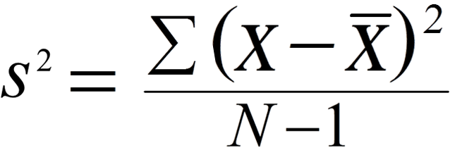

Variance
the population variance, is the variance of the full population.
sample variance, is the variance in the data sampled, and

Slide 31
Variance
the population variance, is the variance of the full population.
sample variance, is the variance in the data sampled, and

Slide 32
Variance
Variance tells us how far the data is from the mean.
It changes for sample and population
Var=np.var(x)

Slide 33
Standard deviation
standard deviation is a measure of how spread out the data is relative to the mean.
If the data is tightly clustered around the mean, then the standard deviation is small. If the data is more spread out, the standard deviation is larger.
The standard deviation is a yardstick to measure/express how exceptional the data is.

Slide 34
Standard deviation
standard deviation is the square root of the variance,
and the sample standard deviation the square root of the sample variance:
S=sqrt(var)
Variance gives rough idea of spread
S.D. gives more concrete information about the exact distances from the mean
Std=np.std(x)

Slide 35
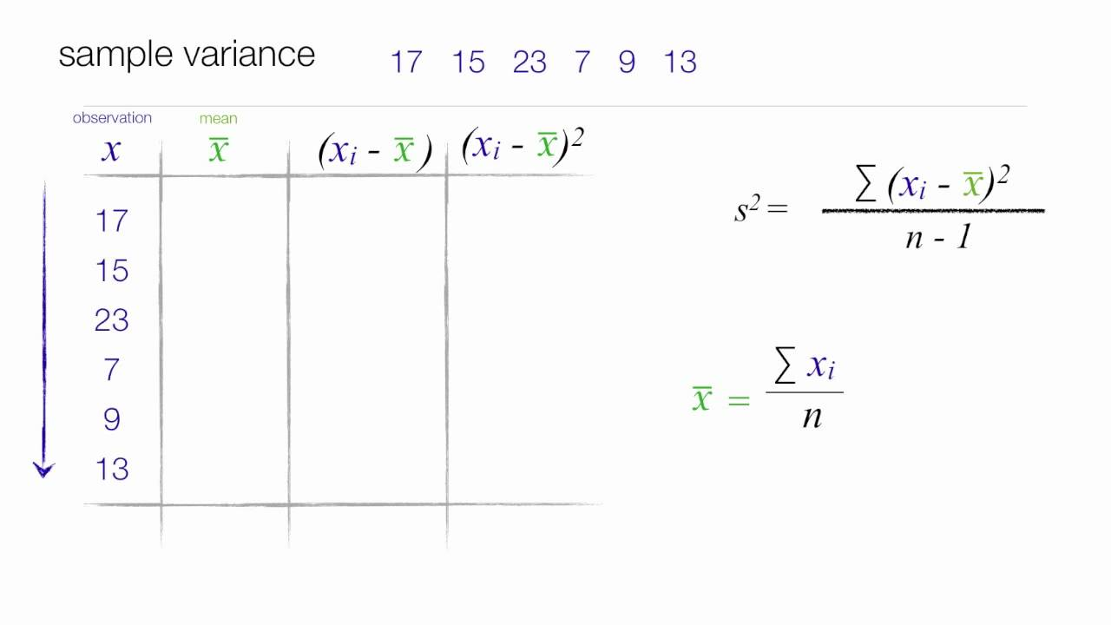
Standard deviation

Slide 36
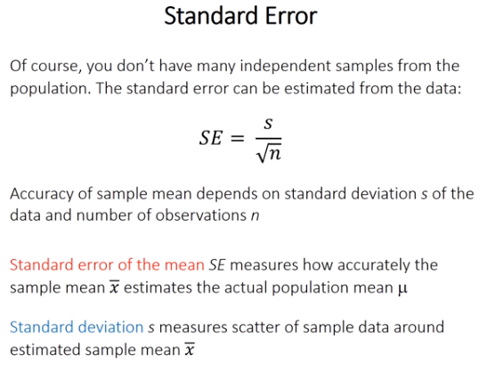
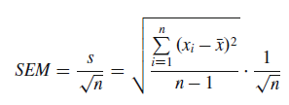

Slide 37
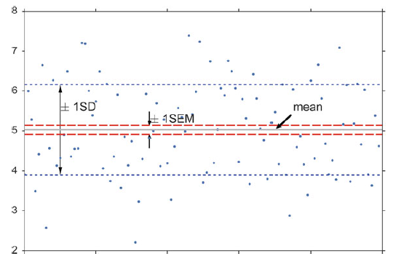


Slide 38
Degrees of freedom (DOF)
DOF is the number of values in the final calculation of a statistic that are free to vary.
A group of n values has n DOF
This is clearest for n = 2: if we know the mean value and the value of sample1, then we can calculate the value of sample2 by val2 = 2 * mean - val1

Slide 39
Probability Distributions
The mathematical tools to describe the distribution of numerical data in populations and samples are probability distributions.
  Discrete Distributions
  Continuous Distributions

Slide 40


Discrete Distributions
Ex: game of throwing dice: for each of the numbers i, the probability that at the throw of a die the side showing the number i faces upward,

Slide 41

Continuous Distributions
The curve describing the probability for each value, i.e., the probability distribution, is a continuous function, the probability density function (PDF).
The PDF p(x) has the following properties:

Slide 42
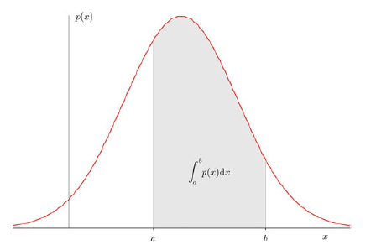
Continuous Distributions

Slide 43


Expected Value
continuous distribution of X:
discrete distributions:

Slide 44

Variance
The variability of the data is characterized by the variance of the data:

Slide 45
univariate distributions
Distributions of one variable are called univariate distributions.
Ex:
the number of children
the weight of a person

Slide 46
Types of Variables
Variables can be classified as discrete or continuous.
discrete distributions, where the observations can only take on integer values (e.g., the number of children); and
continuous distributions, where the observation variables are float values (e.g., the weight of a person).

